Slide 1
Payments Basics: An Overview
Presentation

Slide 2

Agenda
Definition
Key Terms
Scheme
Clearing
Settlement
Payment Flow
Message Standards

Slide 3
What is a Payment?
A payment is the transfer of money from one party (such as a person or company) to another.
Payments are transferred by means of electronic messages
Mostly SWIFT network is used to transfer International Banking Payments

Slide 4







Sample Payment Flow
MT103 (50 EUR)
MT103 (50 EUR)
Mr. Edward
Debit Party
Barclays, UK (BARCGB22)
Debit Party Agent
Mrs. Elaine
Credit Party
XCT BANK-1, Belgium
(XCTABEBB)
Credit Party Agent
Mr. Edward wants to transfer 50 EURO to Mrs. Elaine.
Mr. Edward have an Account at Barclays Bank while Mrs. Elaine have an Account at XCT Bank -1.
Mr. Edward initiates a Payment via Mobile Banking, Internet Banking or Cheque Transfer.
Barclays Bank process the request from Mr. Edward while debiting his account with 50 Euro and crediting 50 Euro in its Internal Account.
Barclays Bank, to narrate this whole story, creates & send a message MT103 over SwiftGateway.
From its Internal Account, Barclays Bank transfers the amount in XCT Bank -1’s Vostro Account at Barclays Bank.
SwiftGateway validate the file and forward it to be received by XCT- Bank-1.

Slide 5
Key Terms & Parties

Slide 6
Key Terms
Debit Account
Account from which the payment is to be made
Credit Account
Account to which the payment is to be made
Reference Id
Identification details of the payment
Settlement Day
The day on which the transfer of funds occur.
Settlement Amount
The amount of the transfer.
Settlement Currency
The currency of the transfer.

Slide 7
Key Terms
Credit Transfer
A Credit Transfer is a payment debiting a bank account and crediting another bank account
Direct Debit
Direct Debit allows a creditor (e.g. biller) to collect funds from a debtor's (payer's) account, provided that a signed mandate has been granted by the payer to the biller. A mandate is signed by the debtor to authorize the creditor to collect a payment and to instruct the debtor's bank to pay those collections
Standing Order
A standing order (or a standing instruction) is an instruction a bank account holder (payer) gives to his or her bank to pay a set amount at regular intervals to another (payee's) account

Slide 8
Key Parties
Debit party / Originating party Party that owes an amount of money to the credit party
Credit party Party to which an amount of money is due
Initiating party Party that initiates the payment
Debit party agent / Originating party agent Financial institution servicing an account for the debit party
Credit party agent Financial institution servicing an account for the credit party
Intermediary agent Financial institution between the debit party agent and credit party agent
Instructing Agent (Instr) / Sending party Agent that instructs the next party in the chain to carry out the payment
Instructed Agent (Instr) / Receiving party Agent that is instructed by the previous party in the chain to carry out the payment (receiver)

Slide 9
Payment Scheme

Slide 10
What is a Payment Scheme?
Scheme provides set of rules and technical standards for the execution of payment transactions
Payment schemes facilitate funds transfer between its member banks.
Banks can be a direct participant or indirect participant to get their payments processed through that scheme
Some standard guidelines in each scheme are
Currency of the funds that can be exchanged
Account/Bank identifier standards
Standard message formats used to exchange messages
Rules for 'R' transactions (refunds, returns and rejects)
Timelines to be observed by payment service providers when executing a payment transaction.
E.g. SEPA, CHAPS, CHIPS, Target 2 etc.

Slide 11
Clearing

Slide 12
What is Clearing?
The interbank exchange and processing of payment instructions, with the view of calculating and establishing respective bank debit and credit positions available for settlement. The latter is referred to as netting.
The process of transmitting, reconciling, potentially including the netting of orders and the establishment of final positions for settlement.
Clearing

Slide 13



Clearing..
All banks have an agreement with a central institution: Clearing House
Clearing house is a common processing mechanism/entity through which the participating banks agree to exchange transfer instructions for payments.
The Clearing House maintains the positions of each participating bank.
World Company
Clarity Bank
Cash Bank
Clearing House

Slide 14
Clearing..
Clearing system (CSM)
A set of procedures whereby financial institutions present and exchange data relating to transfers to other financial institutions.
The procedures often also include a mechanism for the calculation of participants’ mutual positions, potentially on a net basis, with a view to facilitating the settlement of their obligations.

Slide 15
Settlement

Slide 16
What is Settlement?
Payment of the interbank obligations arising from the respective debit and credit positions resulting from the clearing.
The completion of a transaction or of processing with the aim of discharging participants’ obligations through the transfer of funds
Movement of actual funds

Slide 17

Settlement…
Clearing
Payments for a total
value of
€
1.000.000
Payments for a total
Bank A
value of
€
8.000.000
Bank B
Netting: Bank A owes Bank B
€
7.000.0000
Settlement
Bank A pays Bank B
€
7.000.000
Bank A
Bank B

Slide 18
Settlement…
Net settlement: the settlement of transfer orders on a net basis.
Gross settlement: the settlement of transfer orders one by one.
Internal settlement: settlement that is effected through transfers of funds on the books of a bank, as opposed to settlement via an interbank funds transfer system or a central system.
Domestic settlement: settlement which takes place in the country (or currency area) in which both parties to the transaction are located.
Cross-border settlement: settlement that takes place in a country (or currency area) in which one or both parties to the transaction are not located.

Slide 19
Settlement Methods
Book Transfer
Correspondent Banking (Nostro / Vostro)
Clearing and Settlement Method (CSM)
Cover Method
Serial Method

Slide 20


Settlement Method - Book Transfer
This is an example of Internal Settlement
When Debit Party and Credit Party have accounts in the same financial institution
There is no payment message going out of the bank
Only accounting entries are made to move money from Debit Party account to Credit Party account
MT101
(EUR)
Big Company,
Belgium
XCT BANK-1,
Belgium
(XCTABEBB)
Truck Corp.
Big Company
Truck Corp.
1000 EUR
1000 EUR

Slide 21

Settlement Method - Correspondent Banking (Nostro/Vostro)
A bank holds accounts at one (or more) other correspondent banks for each (main) currency it settles payments in.
The bank that owns a correspondent account at another bank refers to such account as a Nostro account ("our account at your bank"). The correspondent bank will refer to the same account as a Vostro account ("your account with us").
These correspondent banks handle payments for the banks they service an account for.
Relationships are typically reciprocal.
MT101
MT103
(GBP)
Big Company,
Belgium
XCT BANK-1, Belgium
(XCTABEBB)
Barclays, UK (BARCGB22)
Toblerone UK
(XCT Bank’s Account at Barclays Bank)
D $ C
NOSTRO account from
XCT Bank’s perspective
VOSTRO account from
Barclays Bank’s perspective

Slide 22


Settlement Method – CSM (Clearing and Settlement Method)
Banks hold NOSTRO account with the Clearing house
Clearing System/house does the settlement by debiting one bank’s account and crediting other’s
Mostly used for domestic clearing and settlement e.g. SEPA
MT103
(1000001 EUR)
Nordea,
Denmark
Clearing
House
Banca Toscana S.P.A. (PASCITMM)

Slide 23


Settlement Method - Cover
“Typical” European method
Used for scenarios where debit party agent and credit party agent do not have Nostro/Vostro relationship but they can be reached over SWIFT network.
A Cover (typically MT202-COV/MT910) is sent via OPF Bank’s correspondents towards the credit party agent to settle the payment
An Announcement (typically MT103) is sent as close as possible, to the credit party agent, to inform the credit party agent that funds will arrive
COV
103
Announcement

Slide 24
Settlement Method - Serial
“Typical” US method
Mostly used for scenarios where debit party and credit party agent do not have Nostro/Vostro relationship and they are NOT connected via SWIFT network
Payment (typically MT103) sent via the OPF Bank’s correspondents towards the credit party agent and settled based on the message
No announcement is sent in this case
103

Slide 25
SWIFT Standards

Slide 26
What is SWIFT?
SWIFT stands for Society for Worldwide InterBank Financial Telecommunications.
An automated payment system used to transfer funds between different countries.
SWIFT is
A cooperative organization created and owned by banks which operates a network to facilitate the exchange of payment and other financial messages between financial institutions throughout the world.
A messaging network. Note that SWIFT does NOT move any money.
The most widely used Financial Network on the planet
Two different message standards
MT (Text Format)
MX (XML Format)

Slide 27
SWIFT MT- Message Structure
SWIFT MT messages are denoted by MTnnn
where
MT is the prefix,
First digit (n) denotes the category of the message,
Second digit (n) denotes the group of related parts in a transaction life cycle,
Third digit (n) denotes the specific message.
E.g. MT103 – Single Customer Credit Transfer message
Each MT message consists of five blocks of data including three headers, message content, and a trailer

Slide 28
Sample SWIFT MT Message
Basic Header Block
{1:F01XCTBBEBBAXXX0304503716}
{2:O1030707100510BARCGB22ATRD50370120101005101001N}
{3:{119:STP}}
{4:
:20:HISTORY-DEMO
:23B:CRED
:23E:SDVA
:32A:101125EUR100000,
:33B:EUR100000,
:50K:TOBLERONE
:57A:XCTBBEBB
:59:/BE85999107547206
SMALL COMPANY
BE
:71A:OUR
-}
{5:{PDE:100510WDCMESESDXXX0987654321}{PDM:100510XCTABEBBAXXX1234567890}}
Application Header Block
User Header Block
Text Block or body
Trailer Block

Slide 29
SWIFT – MX Standard
SWIFT MX is more flexible and easier to implement than the previous generation of message types (MT).
These message types are developed in accordance with ISO 20022 standard.
Current syntax is as following: xxxx.nnn.aaa.bb where
xxxx is an alphabetic code in four positions (fixed length) identifying the Business Process
nnn is an alphanumeric code in three positions (fixed length) identifying the Message Functionality
aaa is a numeric code in three positions (fixed length) identifying a particular flavour (variant) of Message Functionality
bb is a numeric code in two positions (fixed length) identifying the version.

Slide 30
MT to MX Mapping
Most of the SWIFT MT messages can be mapped to MX messages.
E.g.
MT Message | MX Message
MT101 (Request for Transfer) | pain.001.001.03 (CustomerCreditTransferInitiationV03 )
MT202 (General Financial Institution Transfer) | pacs.009.001.02 (FinancialInstitutionCreditTransferV02 )

Slide 31
Clear2Pay
An introduction to OPF PAYMENT

Slide 32
Objectives
Guided tour to OPF PAYMENT with focus on functional aspects
Introduction to main notions and terms used
Overview of the flows
Basis to the next sessions

Slide 33
Agenda
Introduction to Payments
Some OPF PAYMMENT terms and entities
OPF PAYMENT Flows
Accounting
R-Transactions
Formats
Exchange Conditions

Slide 34
1. Payments: Types of payments
PEX = Payment Execution system
Type of payments:
Credit Transfers
Direct Debits
Cheques
Credit Cards
…
Domestic/International Payments
Between customers or between banks

Slide 35
1. Payments
Domestic payments: Credit Party and Debit Party are in the same currency zone and payment is made in the currency of the currency zone.
In Europe, payments in EUR inside the EURO zone are domestic payments.
International payments: … not … or … not …
A USD payment between two EURO customers
A EUR payment between two US customers
A EUR payment between a EURO customer and an US customer.

Slide 36
1. Payments: On-Us / Not-on-us
On-us: the destination account is inside the receiving bank.
Not-on-us: the destination account is not in the books of the receiving bank
Unlimited Ltd
= Credit Party
Credit Advice
And/or
Statements
World Company
= Debit Party
B. On-Us
ACME
= Credit Party
A. On-us
A. Pay ACME 1 000 EUR
At Cash Bank
A. Not-on-us
Credit Advice
And/or
Statements
B. Pay Unlimited 500 EUR
At Clarity Bank
Clarity Bank
= Debit Party Agent
Cash Bank
= Credit Party Agent
Payment A is Not-on-us
Payment B is on-us
Payment A is on-us

Slide 37
1. Debit Leg / Credit Leg
Credit Transfer received from a customer
World Company
Small Comp.
Pay ACME 1 000 EUR
At Cash Bank
From my account XYZ
Clarity Bank
Cash Bank
Pay Small Comp. 1 000 EUR
At Cash Bank
From my account XYZ
Credit Leg:
Transaction
Instruction
Debit Leg

Slide 38

1. Debit Leg / Credit Leg
Direct Debit received from a customer
Phone Company
Debit Laurent X
Debit Christophe Y
Debit Thierry Z
Debit …
Credit my account XYZ
Clarity Bank
Debit Laurent
Debit Christophe
Debit Thierry
Debit …
Credit my account XYZ
Debit Leg:
Transactions
Instruction
Credit Leg

Slide 39
Agenda
Introduction to Payments
Some OPF PAYMENT terms and entities
OPF PAYMENT Flows
Accounting
R-Transactions
Formats
Exchange Conditions

Slide 40
Agenda
OPF PAYMENT Terms and entities
Data Model & Data Dictionary
Payment entities
Scheme
Exchange Partner

Slide 41
2. Data Model & Data Dictionary
All functional entities are described in the VSDK
The Functional Data Model will be presented in a separate session
Functional Entities can more or less be seen as tables
All entities have attributes. These are described in the VSDK
The attributes of an entity are either
Columns of a Table
Or stored in XML in the table
Usage of XML eases the customization of the attributes: new attributes can easily be added.

Slide 42
Agenda
Introduction to Payments
Some OPF PAYMENT terms and entities
OPF PAYMENT Flows
Accounting
R-Transactions
Formats
Exchange Conditions

Slide 43
Agenda
OPF PAYMENT Flows
Overview of Flows
Instruction & Transaction Flows
Main services: validation, routing, submission

Slide 44
3. Interchange/Instruction Flows
Credit Leg

Slide 45
3. Transaction Flows
Debit Leg

Slide 46
3. Parser and Data Dictionary
When an Interchange is received, it is parsed
One Interchange record is created
One or several Instruction records are created
One or several Transaction records are created
Properties are mapped to “Data Dictionaries”
For instance: settlementDay, settlementAmount, settlementCurrency, …
All values are stored in a XML “blob”
Data Dictionary is based on ISO 20022 standards, with some adaptations
Customizations & regional requirements makes it impossible to have one unique Data Dictionary -> Possible to add new attributes
Using standard data dictionary enhance code-reusability and allows processing to be format-independent
Data Dictionary is documented in an Excel spreadsheet

Slide 47
3. Submission Flow
At the end of their Transaction Flow, the Transactions are marked as “ready to be submitted”.
Thanks to the Exchange Timing, a scheduler can start the submission at the appropriate time.
For Not-On-Us Transactions, submitter will:
Group Transactions destined to the same Exchange Partner
Further group the Transactions in Instructions, and Instructions in Interchanges according to Grouping Rules
Submit the Interchanges
For On-Us Transactions, submitter will generate accounting information that can be used by the AMS of the bank.

Slide 48
3. Submission: Grouping

Slide 49
3. Submission Flow

Slide 50
Agenda
Introduction to Payments
Some OPF PAYMENT terms and entities
OPF PAYMENT Flows
Accounting
R-Transactions
Formats
Exchange Conditions

Slide 51
Agenda
Accounting
Accounting
Accounting Events and Exchange Events
Accounting Chart
Exchange Reconciliation and Water-tightness

Slide 52
4. Accounting: simplified
World Company
Small Comp.
Pay ACME 1 000 EUR
At Cash Bank
From my account XYZ
Clarity Bank
Cash Bank
World Company
Nostro @ Cash Bank
Vostro
Small Comp.
1000 EUR
1000 EUR
1000 EUR
1000 EUR
Objective: allow the AMS to know which account was debited when for which account. OPF doesn’t do the accounting, it helps the AMS doing it.
In the example above:
World Company’s account is debited
Small Comp.’s account is credited
Assumption: Clarity Bank has an account at Cash Bank
Nostro & Vostro are always “mirror” of each other. The Nostro account is sometimes referred as the “mirror” Nostro.

Slide 53
Agenda
Introduction to Payments
Some OPF PAYMENT terms and entities
OPF PAYMENT Flows
Accounting
R-Transactions
Formats
Exchange Conditions

Slide 54
5. R-Transactions
R-Transaction: a Transaction that relates to another transaction, previously received, and that aims to “cancel” or “reject” it.
R-Transaction can be created by the system (for instance to reject a Transaction that failed a validation), or received from other parties
Two types of R-Transactions
Reject:
Cancel
Reconciliation service: a service that allows to find the original Transaction for a received R-Transaction
R-Transaction are routed as any other Transaction.
1. Transaction
2. Reject
1. Transaction
2. Cancel

Slide 55
5. R-Transactions
Some schemes allow R-Transactions, some scheme don’t.
Some scheme allow several levels of R-Transaction: you can reject an R-Transaction.
Examples:
SEPA Direct Debit: R-Transaction Level 1
International Payments: No R-Transaction
NACHA: R-Transactions Level 3 (?)
When OPF must reject a transaction, it will “consult” custom code to determine if R-Transactions are allowed for this Transaction or not.
If yes, an R-Transaction is created. It will be routed and submitted as any other transaction
If no, the Transaction to be rejected is “routed to a suspense account”: dead end for the transaction
1. Transaction
2. Reject Level 1
3. Reject Level 2
4. Reject Level 3

Slide 56
Agenda
Introduction to Payments
Some PEX terms and entities
PEX Flows
Accounting
R-Transactions
Formats
Exchange Conditions

Slide 57
6. Formats: ISO20022
XML Based format
SEPA CT and DD uses ISO20022
Payment Initiation
CustomerDirectDebitInitiation
CustomerCreditTransferInitiation
CustomerPaymentReversal
Payments Clearing and Settlement
FIToFICustomerCreditTransfer
FIToFICustomerDirectDebit
FIToFIPaymentReversal
FinancialInstitutionCreditTransfer
PaymentCancellationRequest
PaymentReturn
PaymentStatusReport

Slide 58
6. SWIFTNet format
SWIFT is a network used by banks to exchange financial information in a reliable an secure way
SWIFT uses another ISO standard for the format of the exchanged payments, but will move to ISO20022. This will take time however.
SWIFT messages are text-based
Payment Initiation
MT101 = equivalent of CustomerCreditTransferInitiation
Payment Clearing and Settlement
MT103 and MT102 = equivalent of FIToFICustomerCreditTransfer
MT202/MT203 = FinancialInstitutionCreditTransfer
A message is composed of “blocks”: {1: …}{2: }
The “user” block (4) contains the details of the message. It is “tag” based:
:32A: contains the value date, and settlement amount
:59A: contains the beneficiary

Slide 59
5. SWIFT Message
{1:F01BANKBEBB2222123456}{2:I103BANKDEFFXXXXU3003}{4:
:20:PAYREFTB54302
:32A:970103BEF1000000,
:50:CUSTOMER NAME
AND ADDRESS
:59:/123-456-789
BENEFICIARY NAME
AND ADDRESS
-}

Slide 60
Agenda
Introduction to Payments
Some OPF PAYMENT terms and entities
OPF PAYMENT Flows
Accounting
R-Transactions
Formats
Exchange Conditions

Slide 61
OPF Training - Functional Track
Introduction to the Open Payment Framework

Slide 62
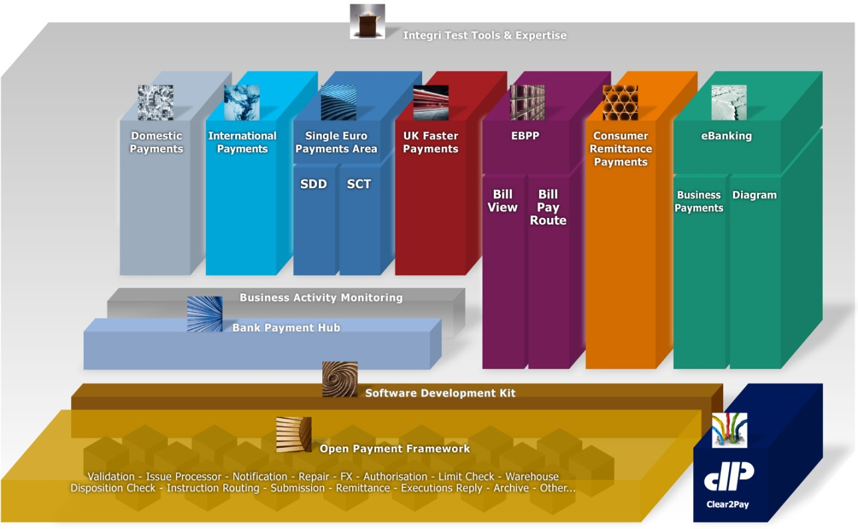
OPF – Open Payment Framework

Slide 63



What is the Open Payment Framework ?
Mission Statement
“OPF is a set of reusable and extensible components, frameworks and technical services for use by the Clear2Pay product development and project engagement teams who want to reuse, customize or extend Clear2Pay’s payments solutions.”
“Service-Oriented Payments”
Flexible and customisable to avoid reinventing the wheel
Delivered by:
“Customized Modules”
Customized
ORM
Customized
SDD
Custom
EBP
Custom
BAS
C2P Project Team
Admin
ORM
SDD
“Product Modules”
C2P Product Team
Open Payment Framework
C2P Core R&D Product Team

Slide 64
Why OPF ?
Maximize reusability of components, frameworks and services
Centralizing core code
Better product quality and improved company reputation for quality
Improve consistency across functional modules of the “standard” product and customization projects
Reduce effort to customize the OPF-based modules
Accelerating the overall time-to-market
Decrease overall support and maintenance overhead cost
SOA benefits

Slide 65


Decoupling
Process Manager from Technology Components
Open Payment Framework
Channels
Parsing
Service
Payment
Instruction
BPM
Orchestrated
Payment
Process Flow
Validation
Service
Enrichment
Service
OFAC / AML
Limit Check
Service
Payment
Repository
(Database)
Forex
Warehouse
Service
Liquidity
Service
Legend
Notification
Service
OFAC / AML
Third party component or service
Routing
Service
Validation
Service
C2P OPF
Business Service
Clearing &
Settlement
Systems
Submitter
Service
. . .

Slide 66
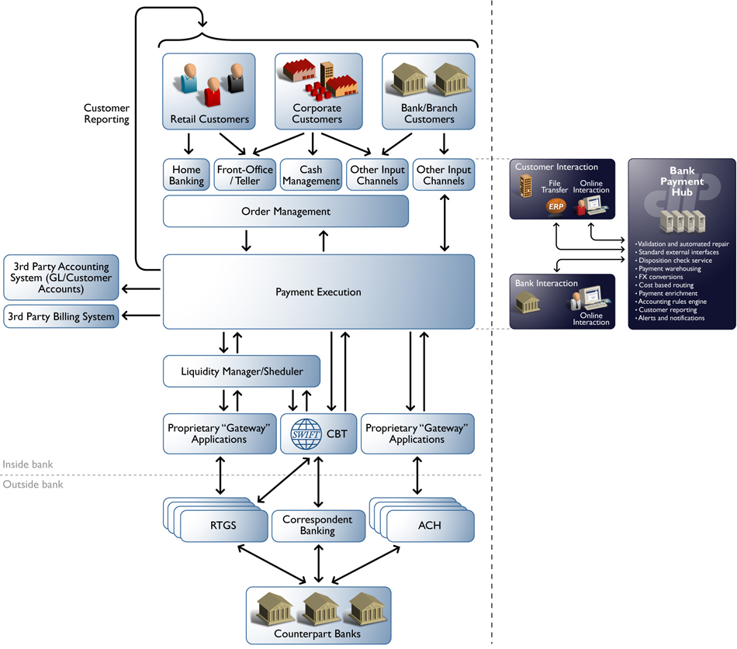
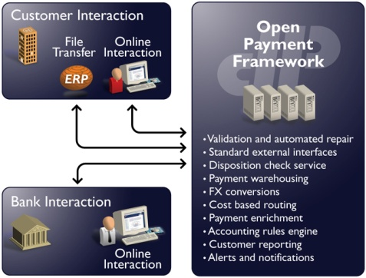
Example of OPF in a bank’s IT infrastructure

Slide 67





OPF -- Multi-Scheme
Multi-Product = Multi-scheme = Multi-PaymentType = Multi-team
SCT + SDD + XCT + UKFP + ... on a single OPF
Concept of “Scheme” : Instruction + Transaction
UKFP
ICT
Retail
EBK
Domestic
BP
OPF
SDD
Corporate
SCT
Rep.FI

Slide 68
Reference Implementation
An OPF reference implementation (RI) is built using the OPF stack of services.
Is an out-of-the-box application that can be deployed to a production site with minimal changes.
Makes use of BPEL orchestration using the Flow initiation service. BPEL helps an RI to choreograph various services to implement the desired business process.
Packed with UI rich features that bridges the gap between any back-end processing and front-end users.

Slide 69

OPF Reference Implementation
Re-use VisApp for customizing
visibility web application
- Re-use payment flows for
customizing flows
- Use SDK to extend
the product modules
.java
.xml
.bpel
Project Implementation
”Reference Implementation”
Reference Implementation:
- Working / Configurable product
- Example Code
- “OPF Project Workspace”
- Build & Deployment Scripts
VisApp
Payment
Flows
SDK
- Source code for
Struts Actions, Forms
- HTML, JSP, CSS
- Source .bpel for
default BPEL flow
- Sample source code
for customization
- Documentation
Pre-defined extension points
Public components
Extension
Points
Module Features & Functionality
Core product functionality
Technical Frameworks
Business Components /Services
Technical Services
EJB/POJO Interfaces, WSDL Interfaces, XML Config files, Property files
ORM (OPF-dependent Module)
Open Payment Framework

Slide 70
OPF Training - Functional Track
OPF – Business domain model

Slide 71

OPF – Business domain model
OPF data model based on ISO20022
OPF data model extended for xCT, in line with ISO20022
What is ISO20022?
Also known as UNIFI (UNIversal Financial Industry message scheme)
Is not a format of a single message, but it’s a messaging standard.
Registered with the ISO organization and Swift is assigned by ISO as the body that maintains the standard.
The standard consists of messages and a library of (standard) data components that are used in these messages

Slide 72
OPF – Business domain model
Why to use ISO20022 as a basis for the data model?
A global standard for payment transactions
Be able to retain information of almost any existing message format in a unified way
Eases conversion from one message format to another
Enables seamless SWIFT-MT, SWIFT-MX (ISO20022) co-existence

Slide 73
OPF – Business domain model
Extension strategy
Challenge is to support the different payments data requirements of different implementations without requiring different database schemas in each implementation
The payments details are generally written to the database and rarely updated. E.g. remittance information
Approach taken is to store payments details in XML format:
XML details: in general, information parsed from an incoming message or information used to format into an outgoing message
XML processing details: captures information during processing, required for later reference

Slide 74
OPF – Business domain model
Documentation:
Business domain model Document which provides models and descriptions of all entities
Data dictionary
All attributes in OPF-xCT-SEPA are identified by their specific attribute name, both for payment entities and so-called static data entities
Documented in the VSDK as distributions:
OPF data dictionary
xCT data dictionary
(containing the xCT extensions to OPF)
SEPA data dictionary
(containing the SEPA extensions to OPF)

Slide 75

Important OPF data model entities
Payment
Participant
Account
Exchange Condition
Exchange schedule and business calendars
Routing
Service, Product, Agreement
Accounting events and exchange reconciliation
Audit&History
Bank group, Bank, Department
Person, User, Role
Reference data

Slide 76
Important OPF data model entities
Payment
Participant
Account
Exchange Condition
Exchange schedule and business calendars
Routing
Service, Product, Agreement
Accounting events and exchange reconciliation
Audit&History
Bank group, Bank, Department
Person, User, Role
Reference data

Slide 77
Interchanges, Instructions, Transactions
Payments in general are stored and structured in OPF’s Payment Registry typically as Instructions and Transactions
When those payments are exchanged between parties via various channels other than online payment entry, the messages are formatted in Interchanges
The atomic entity is the Transaction, grouped in incoming or outgoing Instructions, which on their turn are grouped in an Interchange
Payment

Slide 78
Interchanges, Instructions, Transactions
Payment

Slide 79
Incoming & Outgoing Instructions / Interchanges
Payment

Slide 80
Instruction and Transaction groups
Instruction Groups and Transaction Groups exist in the data model but are only used by implementation teams when appropriate
Their sole purpose is to match closer with the format of the exchange files when this is of interest for the user
“Business” information that is stored at the level of those groups in the file format should be replicated in the Instruction and Transaction.
For instance, if the “Settlement Day” exists in the Instruction Group, it should be copied to all Instructions, because this is where OPF expects to find that information
Payment

Slide 81
Instruction and Transaction groups
Payment

Slide 82
Payment reconciliation
A Payment Reconciliation is a link between two payments entities that are related by business logic. For instance, upon successful reconciliation between an announcement (MT103) and a cover (MT202COV), a Payment Reconciliation is created to store the link between those entities.
Payment Reconciliation is required in two circumstances:
When a Payment Entity is received from an external party, and must be reconciled to an existing Payment Entity in the system.
When a Payment Entity is created by the system, and linked to another Payment Entity already existing in the system.
Payment

Slide 83
Payment reconciliation
Payment

Slide 84
Payment – classification, instruction type
Classification Indicates the nature of the transfer the Instruction or Transaction represents. Most important classifications:
Credit Transfer Initiation (CCTI): classification used for payments that are received from an initiating party. The classification is used to request movement of funds from the debit party account to a credit party. The classification is used for, for example, SWIFT MT101 and PAIN.001 messages.
(FI2FI Customer) Credit Transfer: classification used for payments exchanged between the debit party agent and credit party agent, directly or through other agents and/or a payment clearing and settlement system. It is used to move funds from a debit party account to a credit party. The classification is used for, for example, SWIFT MT103, MT102 and PACS.008 messages.
Financial Institution Credit Transfer: classification used for payments exchanged between a debit party financial institution to a credit party financial institution, directly or through other agents and/or a payment clearing and settlement system. It is used to move funds from a debit party account to a credit party, where both debit party and credit party are financial institutions. system. It is used to move funds from a debit party account to a credit party. The classification is used for, for example, SWIFT MT202 and PACS.009 messages.
Payment

Slide 85
Payment – parties and agents
OPF Bank Bank at which the Clear2Pay OPF system is running
Debit party (Trn) / Originating party (Instr; Customer Initiated Credit Transfer) Party that owes an amount of money to the credit party (50a)
Credit party (Trn) Party to which an amount of money is due (59a)
Ultimate debit party (Trn) Ultimate party that owes an amount of money to the (ultimate) credit party
Ultimate credit party (Trn) Ultimate party to which an amount of money is due
Initiating party (Instr) Party that initiates the payment
Debit party agent (Trn) / Originating party agent (Instr; Customer Initiated Credit Transfer) Financial institution servicing an account for the debit party (sender/52a)
Credit party agent (Trn) Financial institution servicing an account for the credit party (receiver/57a)
Payment

Slide 86
Payment – parties and agents
Intermediary agent (Trn) Financial institution between the debit party agent and credit party agent (56a)
Instructing Agent (Instr) / Sending party (Intchg) Agent that instructs the next party in the chain to carry out the payment (sender)
Instructed Agent (Instr) / Receiving party (Intchg) Agent that is instructed by the previous party in the chain to carry out the payment (receiver)
Forwarding Agent (Instr) Financial institution that receives the instruction from the initiating party and forwards it to the next agent in the payment chain for execution.
Payment
Notes:
Instructing Reimbursement Agent (Instr) Agent through which the instructing agent will reimburse the instructed agent (53a)
Instructed Reimbursement Agent (Instr) Agent at which the instructed agent will be reimbursed (54a)
Third Reimbursement Agent (Instr) Agent at which the instructed agent will be reimbursed (55a)
Previous Instructing Agent (Instr) Agent immediately prior to the instructing agent (:72:/INS)

Slide 87
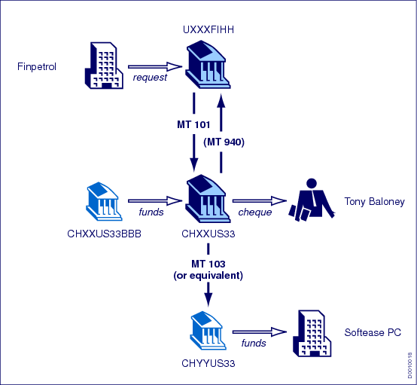
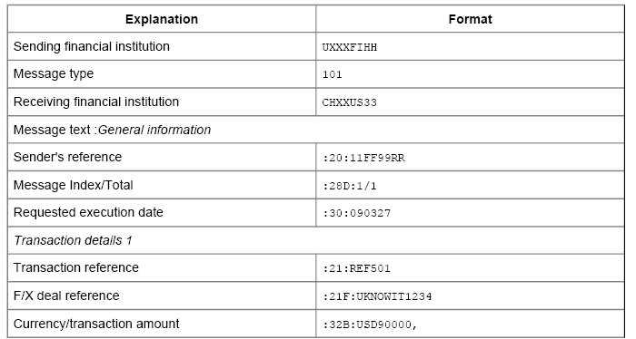
Payment – parties and agents (map MT101)
Originating Party
Sending party
Debit party
Instructing agent
OPF Bank
Receiving party
Instructed agent
Originating Party Agent
Debit party agent
Credit party agent
Credit party
Interchange
Instruction
Transaction
Payment

Slide 88
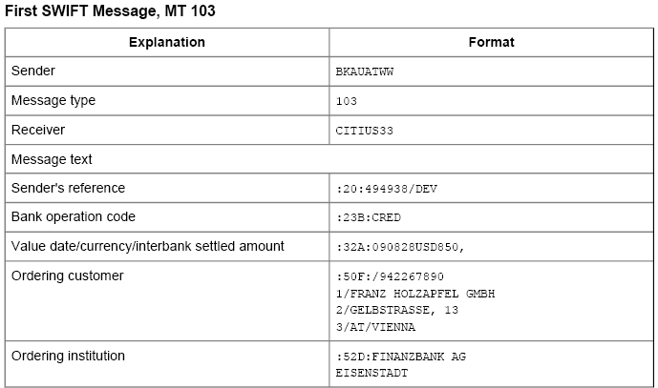
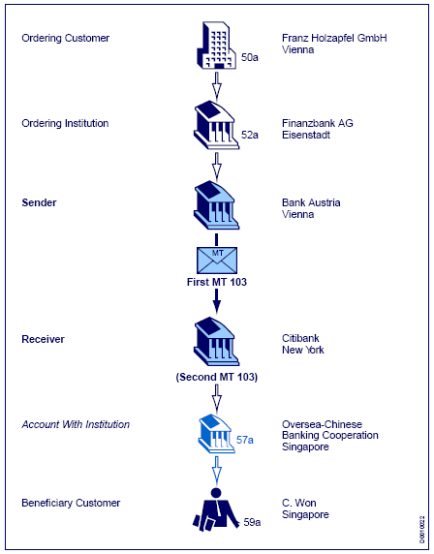
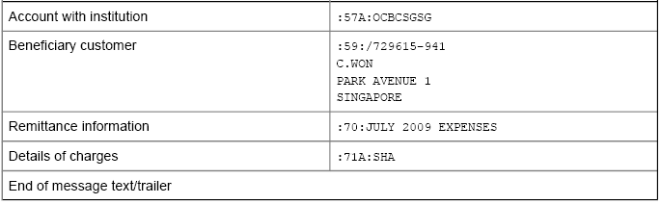
Payment – parties and agents (map MT103)
Debit party
Debit party agent
Sending party
Instructing agent
OPF Bank
Receiving party
Instructed agent
Interchange
Credit party agent
Instruction
Transaction
Credit party
Payment

Slide 89
Payment – parties and agents
Party details (1/3)
Type, Id, Id Type, Id Issuer A party can be identified by an “Id” (e.g. “123-456-7890”) of a certain “Id Type” (e.g. BICorBEI) of a certain “Type” (e.g. Private), issued by an “Id Issuer” (e.g. Belgium):
Examples “Id Type”: SEPA, BICorBEI etc.
Possible values “Type”: Private, Organisation
Name & Adress
Structured:
name, street name, building number, postal code, city, state, country
Semi structured:
name, address line 1-2, City, Postal Code, Country
Unstructured:
name, address line 1-3
Payment

Slide 90
Payment – parties and agents
Party details (2/3)
Account, Account Id Type A party can have an “Account” (e.g. BE28001390079920) of a certain “Account Id Type” (e.g. “IBAN”):
Possible values “Account Id Type”: “BBAN”, “IBAN”, “UPIC”, “Proprietary”
Payment

Slide 91
Payment – on-us, outbound, from-us
Outbound vs. Inbound
Outbound and inbound indicate the “direction” of received payments (Instructions) from the OPF Bank point’s of view.
Outbound means that the payment originates from the OPF Bank (from a bank’s customer or bank’s internal department and other such examples).
Inbound means that the payment originates from another party than the OPF Bank (from a correspondent bank or clearing system and other such examples).
On-us vs. Not on-us
On-us and not on-us indicate the “direction” of a routed payment (transaction) from the OPF Bank point’s of view.
On-us means that the payment is routed to the OPF Bank (intended for a bank’s customer or bank’s internal department and other such examples). The destination account is in the bank’s books.
Not on-us means that the payment is routed to another party than the OPF Bank (to a correspondent bank or clearing system and other such examples). The destination account is not in the bank’s books.
Payment

Slide 92

Payment – on-us, outbound, from-us
Outbound
Inbound
Customer
channel
Small Company
Debit Party
Clarity Bank Belgium
Debit Party Agent
(OPF Bank)
Clearing system
World Company
Credit Party
On-us
Not on-us
Payment

Slide 93


Payment – on-us, outbound, from-us
From-us vs. Not from-us
Indicates for a customer credit transfer initiation (MT101), whether the OPF Bank is the debit party agent of the payment (from-us) or not (not from-us)
From-us payments are “processed” by the OPF Bank
Not from-us payments are forwarded to the debit party agent (relay scenario)
World Company,
Spain
Debit Party
SWIFT
Gateway
World Company,
Belgium
Initiating Party
Clarity Bank Belgium
Forwarding Agent
(OPF Bank)
Big Bank Spain
Debit Party Agent
Credit Party Agent
Fashion Inc
Credit Party
MT101
MT101
Not from-us
Payment

Slide 94
Payment – instructed vs. settlement day
Instructed day Day at which the party initiating a credit transfer initiation requests the OPF Bank to process the payment (equivalent of the SWIFT-MT101’s field 30)
Settlement day Day on which the amount of money ceases to be available to the party that owes it and when the amount of money becomes available to the party to which it is due:
Incoming settlement day: settlement day applicable at the incoming side (debit side for credit transfers) (*)
Outgoing settlement day: settlement day applicable at the outgoing side (credit side for credit transfers) (**)
(*) PaymentInstruction.settlementDay, PaymentTransaction.incomingSettlementDay
(**) PaymentTransaction.settlementday
Payment

Slide 95
Payment – amounts
Instructed amount Amount of money to be moved between the debit party and credit party, before deduction of charges, expressed in the currency as ordered by the initiating party (equivalent of the SWIFT-MT101’s field 32B, if no equivalent amount used)
Equivalent amount Amount of money to be moved between the debit party and credit party, expressed in the currency of the debit party's account (*), and the currency in which the amount is to be moved (**)
(*) PaymentTransaction.equivalentAmount
(**) PaymentTransaction.equivalentAmountCurrencyOfTransfer
Settlement amount Total amount of money settled between a party and the OPF Bank:
Incoming settlement amount: settlement amount settled at the incoming side (*)
Outgoing settlement amount: settlement amount settled at the outgoing side (**)
(*) PaymentInstruction.settlementDay, PaymentTransaction.incomingSettlementDay
(**) PaymentTransaction.settlementday
Payment

Slide 96
Payment – references
Display ids The system assigns a so-called “display id” to each payment entity (Interchange, Instruction, Transaction) it creates. A display id is a unique identifier generated by the system in a human-readable format, and that can be used on the UI and in the content of the submitted payment.
Interchange reference Point to point reference assigned by the sending party and sent to the next party in the chain to unambiguously identify the interchange.
Interchange MIR/MOR (xCT) SWIFT’s Message Input Reference (MIR) and Message Output Reference (MOR) as received in an incoming SWIFT MT message.
Interchange Message user reference (xCT) SWIFT’s Message User Reference (MUR) as received from an incoming SWIFT MT message or provided in a submitted SWIFT MT message. For outgoing messages the reference is taken from the Interchange’s display id.
Payment

Slide 97
Payment – references
Instruction reference Point to point reference assigned by the instructing party and sent to the next party in the chain to unambiguously identify the instruction.
Transaction’s instructing agent transaction id Point to point reference of the Transaction passed by the instructing agent/party, and that should be unique per instructing agent/party. The Transaction has both an incoming and outgoing instructing agent transaction id.
Transaction’s first instructing agent transaction id Unique identification assigned by the first instructing agent to unambiguously identify the transaction and passed on, unchanged, throughout the entire interbank chain.
Transaction’s end to end id Unique identification assigned by the initiating party to unambiguously identify the transaction. This identification is passed on, unchanged, throughout the entire end-to-end chain.
Payment

Slide 98
Payment – other information
Scheme Indicates the scheme under which the Transaction is processed. A scheme has a specific set of rules linked to it, which results in a different behavior in the various OPF services. Possible values of scheme are: ICT, SDDCORE, SDDB2B, SCT and other such schemes.
Settlement method Method used to settle the payment. Possible values are:
Clearing (CLRG): Settlement is done through a payment clearing system.
Cover Method (COVE): Settlement is done through a cover payment.
Instructed Agent (INDA): Settlement is done by the agent instructed to execute a payment instruction (serial method).
Instructing Agent (INGA): Settlement is done by the agent instructing and forwarding the payment to the next party in the payment chain (serial method).
Debit – credit indicator Indicates if a Transaction is a debit ("D") or credit ("C"). E.g. a credit transfer is a credit (the destination account will be credited), a direct debit is a debit.
Exchange rates, Code words, Cheque information, Remittance information...
Payment

Slide 99
Important OPF data model entities
Payment
Participant
Account
Exchange Condition
Exchange schedule and business calendars
Routing
Service, Product, Agreement
Accounting events and exchange reconciliation
Audit&History
Bank group, Bank, Department
Person, User, Role
Reference data

Slide 100
Participant
Participant
A participant is a party who the OPF Bank has an agreement (*) with to process payments.
The Participant can be:
An external Financial Institution: correspondent banks, represented banks, or an agent receiving or sending payments on behalf of one of those
A clearing system
An external non Financial Institution that acts on behalf of a Financial Institution: a Data Processor, a Cheque Printer, …
An Accounting Management System
An “Order Management-type” System
A customer of the OPF Bank
(*) The agreement that exists is not necessarily modeled as an entity in the Business Data Model,
but it exists it the real world.
Participant

Slide 101
Participant
Participant
Notes:
Show Participant BVA

Slide 102
Clearing, Business, Settlement participant
OPF can make the distinction between Clearing, Business and Settlement Participant.
In simple schemes, this distinction is not necessary. Clearing Participant = Business Participant = Settlement Participant
In more complex schemes, it is required.
For instance, Bank A could designate a Payment Processor to which the payments should be sent for Clearing. The Payment Processor will be called the Clearing Participant.
The same Bank A could designate a Central Institution with which Settlement could occur. The Central Institution will be called the Settlement Participant.
Bank A will be called the Business Participant.
To cope with that, OPF supports “Delegation”:
Clearing Delegation
Settlement Delegation
Participant

Slide 103
Clearing, Business, Settlement participant
An Exchange Condition can “delegate” the submission or reception of files to another Participant
This is the case when the Participant that owns the Exchange Condition wants to use another Participant as intermediary between him and the system.
This intermediary Participant also has one or several Exchange Conditions, and one of these Exchange Conditions could specify that a third Participant must be used as intermediary.
Up to 4 delegations are supported, but customization teams may add more if needed.
Participant

Slide 104
Clearing, Business, Settlement participant
A Participant can “delegate” the settlement to another Participant
For instance, to a Central Institution
Or to another subsidiary with a Bank Group
The delegation can be repeated.
Participant

Slide 105
Clearing, Business, Settlement participant
A payment can potentially be linked to six Participants
Incoming Business Participant The previous Agent in the payment processing chain that sent the Transaction to the Financial Institution running the system, either directly (in which case it is the same as the Clearing Participant) or indirectly (in which case the Clearing Participant is the intermediary)
Incoming Settlement Participant The Participant with which the exchange of funds is settled on the incoming side
Incoming Clearing Participant (via a Clearing Condition) The Participant that delivered the Payment Interchange to the system
Outgoing Business Participant The Participant that represents the next Agent in the payment processing chain (in the routing algorithm, this typically the first Participant found, before following any “delegation” link)
Outgoing Settlement Participant The Participant with which the exchange of funds is settled on the outgoing side
Outgoing Clearing Participant (via a Clearing Condition) The Participant to which the system delivers the Payment Interchange
Participant

Slide 106
Clearing, Business, Settlement participant
Incoming Side
The Payment Interchange is linked to the Exchange Condition that was used to receive the file -> “incoming Clearing Condition”
The (incoming) Payment Instruction is linked to the (Incoming) Business Participant and an (Incoming) Settlement Participant. Dedicated services will determine the Business and Settlement Participants
Participant

Slide 107
Clearing, Business, Settlement participant
Outgoing Side
After the Routing Service, a Transaction is linked to
The “Outgoing Clearing Condition” that will be used to submit it
A “Business Participant” that represents the Participant with which the Bank has an agreement to process this transaction
A “Settlement Participant” that represents the party with which this transaction must be settled.
Participant

Slide 108


Clearing, Business, Settlement participant
Example clearing delegation
Bank cheque
print
Bank cheque printer
Outgoing Clearing
Participant
World Company,
Belgium
Debit Party
Clarity Bank Belgium
(BANKBEBB)
Debit /Credit Party Agent
(OPF Bank)
JPMC, UK (CHASGB2L)
Outgoing Business Participant
Outgoing Settlement Participant
MT101
(23:CHQB)
MT110

Slide 109
Clearing, Business, Settlement participant
Example settlement delegation
VOSTRO
HSBC
D
C
X
AMS
Outgoing Clearing Participant
Outgoing Settlement Participant
Banco Santander, Spain
(BSCHESMM)
Debit Party (Agent)
Clarity Bank Belgium
(BANKBEBB)
Credit Party Agent
(OPF Bank)
HSBC Hong Kong
(HSBCHKHHHKH)
Credit Party
Outgoing Business Participant
MT202
MT910

Slide 110
Break 1

Slide 111
Important OPF data model entities
Payment
Participant
Account
Exchange Condition
Exchange schedule and business calendars
Routing
Service, Product, Agreement
Accounting events and exchange reconciliation
Audit&History
Bank group, Bank, Department
Person, User, Role
Reference data

Slide 112
Account
Account In banking, an Account is typically defined as “the formal record of transactions of a particular type expressed in money and maintained in a ledger”. Following kinds of accounts are kept in the OPF system:
Account (Processing Account) An Account can be specified in a Participant’s (Processing)Agreement so that payments “using” the account are processed within the terms of that Agreement.
AMS Account “Mirror” of the AMS accounts. Used specifically for disposition check purposes.
Settlement Account (xCT) A settlement account is a specific purpose account used to post debit and credit entries as a result of the payment. A Participant can have mutliple settlement accounts defined. E.g. Mirror-NOSTRO account of the OPF Bank’s USD Correspondent Bank.
Internal Account (xCT) OPF Bank’s internal account (G/L accounts)
Account

Slide 113
Important OPF data model entities
Payment
Participant
Account
Exchange Condition
Exchange schedule and business calendars
Routing
Service, Product, Agreement
Accounting events and exchange reconciliation
Audit&History
Bank group, Bank, Department
Person, User, Role
Reference data

Slide 114
Exchange Condition
Exchange Condition
An Exchange Condition is a set of attributes that describe how files are sent/received files to/from a Participant.
Typical attributes: format, grouping rules, destination code, submission queues, …
An Exchange Condition can apply to incoming or outgoing files (or both):
An incoming Exchange Condition will typically be used to validate a received file.
An outgoing Exchange Condition will typically be used to route and submit the file.
Exchange Conditions are linked to Exchange Schedules to determine when submission occurs.
Exchange Condition
Notes:
Show Exchange Condition BVA

Slide 115
Exchange Condition
Exchange Condition
A Participant is linked to 0, 1 or more Exchange Conditions.
An Exchange Condition is always linked to one Participant
Exchange Condition
Notes:
Stop Point: Show on BVA

Slide 116
Important OPF data model entities
Payment
Participant
Account
Exchange Condition
Exchange schedule and business calendars
Routing
Service, Product, Agreement
Accounting events and exchange reconciliation
Audit&History
Bank group, Bank, Department
Person, User, Role
Reference data

Slide 117
Exchange schedule & Business Calendars
Exchange schedule An Exchange Schedule is used to determine when transactions resorting to an Exchange Condition must be exchanged between the system and the Participant.
Exchange schedule and business calendars

Slide 118
Exchange schedule & Business Calendars
Business Calendar A Business Calendar defines business and non-business days for the entities it is “linked” to:
An Exchange Condition may be linked to a “Submission” Calendar
A Participant may be linked to a “Settlement” Calendar
A Bank maybe linked to the “Bank’s” Calendar
A Currency maybe linked to the “Currency” Calendar (attribute on Calendar)
Exchange schedule and business calendars
Notes:
Stop Point: Show on BVA

Slide 119
Important OPF data model entities
Payment
Participant
Account
Exchange Condition
Exchange schedule and business calendars
Routing
Service, Product, Agreement
Accounting events and exchange reconciliation
Audit&History
Bank group, Bank, Department
Person, User, Role
Reference data

Slide 120
Routing
Routing
Routing is the process by which the destination of a received payment is found
Routing must assign each Transaction an Outgoing Clearing Condition
Routing will also assign an Outgoing Business Participant and an Outgoing Settlement Participant
Routing determines whether a Transaction is on-us or not on-us
Routing relies on an ordered list of “Routing Rules”, which can be of two types
“Criteria Based”: certain attributes of the Transaction are compared with attributes of the Exchange Condition. If all criteria matched, the Transaction is routed to the Exchange Condition. For instance: Currency, Maximum Amount, Destination Bank Code, …
“Algorithm Based”: the Routing Rule consists of code developed by customization team, which, for a Transaction received as parameter, will return the Outgoing Clearing Condition.
Each Routing Rule is evaluated up until a Clearing Condition is found
Routing

Slide 121
Routing
Participation Directory
A Participation Directory is a list of agent codes that the attached entity (EC) represents in the system.
If the Participant is a clearing house, the Participation Directory lists all the bank codes of the banks that can be reached (= are participants) via this clearing house.
If the Participant is a bank, the Participation Directory lists all the banks that are represented by this bank
Participation Directory is to be used as a Criteria of a Routing Rule.
The Criteria would say something like: Destination BIC must be listed in Participation Directory linked to the Exchange Condition
Routing
Notes:
Stop Point: Show on BVA

Slide 122
Important OPF data model entities
Payment
Participant
Account
Exchange Condition
Exchange schedule and business calendars
Routing
Service, Product, Agreement
Accounting events and exchange reconciliation
Audit&History
Bank group, Bank, Department
Person, User, Role
Reference data

Slide 123
Service – Product – Agreement
Service An OPF Bank, can offer various services to their Participants. These Services are defined per Bank Group. From a high level, those services can be categorized as:
Processing Service: service related to the ‘processing’ of payments. E.g. “currency conversion” and other such processing services.
Visibility Service: service related to ‘visibility’ access. E.g. “manual entry” (order management)
Product A product is a collection of Services offered as a Product by an OPF Bank to its Participants. Products are defined per Bank. Products can be categorized as:
Processing Product: product related to the ‘processing’ of payments. E.g. “International Credit Transfer - Customer Initiation – CorpDirect” which is a product offered by the OPF Bank to corporates (identified via processing accounts) to send in SWIFT MT101 messages.
Visibility Product: product related to ‘visibility’ access.
Service, Product, Agreement

Slide 124
Service – Product – Agreement
Agreement An Agreement details a Participant’s use of a Product. Agreements are defined per Participant. Agreements can be categorized as:
Processing Agreement: Agreement related to the ‘processing’ of payments. E.g. “International Credit Transfer - Customer Initiation – CorpDirect - Gold”. The Participant which has the agreement has better conditions in terms of currency conversion and charges than the related product.
Visibility Agreement: Agreement related to ‘visibility’ access.
Service, Product, Agreement

Slide 125
Service – Product – Agreement
Service Attributes Attributes that define settings and constraints in relation to a Service supported by the OPF:
Processing Service Attributes
Visibility Service Attributes
Product Service Attributes Service Attributes can be overridden on Product level. These are referred to as Product Service Attributes. These attributes define how a Service will be utilized / applied for a given Product:
Processing Product Service Attributes
Visibility Product Service Attributes
Agreement Service Attributes Service Attributes can be overridden on Agreement level. These are referred to as Agreement Service Attributes. These attributes define how a Service will be utilized / applied for a given Agreement:
Processing Agreement Service Attributes
Visibility Agreement Service Attributes
Service, Product, Agreement

Slide 126
Service – Product – Agreement
Service, Product, Agreement
Notes:
Stop Point: Show on BVA

Slide 127
Important OPF data model entities
Payment
Participant
Account
Exchange Condition
Exchange schedule and business calendars
Routing
Service, Product, Agreement
Accounting events and exchange reconciliation
Audit&History
Bank group, Bank, Department
Person, User, Role
Reference data

Slide 128
Accounting events & exchange reconciliation
Accounting event
Representation of the fact that one or more accounting entries must be created as a result of a step in the processing of a Payment Transaction or Instruction.
Contains contextual information about the event that requires an Accounting Entry to be created, such as an Event Code, a Payment Transaction Id, etc.
Does not contain the details of the Accounting Entry itself.
Accounting events and exchange reconciliation

Slide 129
Accounting events & exchange reconciliation
Exchange Event An Exchange Event records the exchange of a payment or group of payments with a Clearing Participant, or with an internal partner (for instance, the BVA).
Accounting events and exchange reconciliation

Slide 130
Accounting events & exchange reconciliation
Exchange Reconciliation
Replaces the concept of “Position keeping”.
Is based on Exchange Events:
When Payments are received, an “incoming” Exchange Event is created
When Payments are sent, an “outgoing” Exchange Event is created
By comparing “Incoming” Exchange Events and “Outgoing” Exchange Events for a specific day, one can make sure no payment was “lost” (so called “water-tightness”)
By summing Exchange Events for a specific Participant, one can know how many payments were received or sent to that Participant. It can be used to facilitate the end-of-day reconciliation.
Accounting events and exchange reconciliation

Slide 131
Important OPF data model entities
Payment
Participant
Account
Exchange Condition
Exchange schedule and business calendars
Routing
Service, Product, Agreement
Accounting events and exchange reconciliation
Audit&History
Bank group, Bank, Department
Person, User, Role
Reference data

Slide 132
Audit & History
Audit
Audit event
A list of Functions (actions and events) that require a historical record to be captured for audit purposes in Audit Record.
The action or event may be executed by a Person or by an automated process or service.
Audit record
The specific record capturing the history for an Audit Event.
Capture the timestamp and User who initiated the action.
For CRUD functions, this will capture the changes to each field.
History A history (audit trail of all details) of state changes for a payment interchange, payment instruction or payment transaction.
Audit&History
Notes:
Stop Point: Show on BVA

Slide 133
Important OPF data model entities
Payment
Participant
Account
Exchange Condition
Exchange schedule and business calendars
Routing
Service, Product, Agreement
Accounting events and exchange reconciliation
Audit&History
Bank group, Bank, Department
Person, User, Role
Reference data

Slide 134
Bank group, Bank, Department
Bank group A Bank Group is a group of Banks or other Financial Institutions that are members of a common group or corporation. For example:
A Multinational Bank that has banking licences and operations in a number of different countries
A Financial Services Group that consists of a group of Financial Institutions that operate together on a local, national or multinational basis to provide a broad range of financial services
Bank A Bank is a type of Financial Institution that holds a license to provide banking services within a certain jurisdiction (e.g. within a country or state).
Department A Bank will have many Bank Departments which could represent Branches, Departments, Organizational Units, and so on.
Bank group, Bank, Department

Slide 135
Bank group, Bank, Department
Bank group, Bank, Department
Notes:
Stop Point: Show on BVA

Slide 136
Important OPF data model entities
Payment
Participant
Account
Exchange Condition
Exchange schedule and business calendars
Routing
Service, Product, Agreement
Accounting events and exchange reconciliation
Audit&History
Bank group, Bank, Department
Person, User, Role
Reference data

Slide 137
Person, User, User Role
Person
The OPF is accessible by human beings i.e. a Person on behalf of a Bank Department or Participant:
A Person representing a Bank will access the OPF via the BVA
A Person representing a Participant will access the OPF via the CVA
A Person will have a single physical login
A Person can have multiple Users assigned (i.e. Bank or Customer User)
User
Bank User A Bank User is a Person that uses the OPF on behalf of a Bank Department
Customer User A Customer User is a Person that uses the OPF on behalf of a Participant
Person, User, Role

Slide 138
Person, User, User Role
User Role
Bank User Role Defines the Data that users of the role may access, together with the Bank Functions they may perform on that data. These data and function permissions are defined using Bank Function Access Profile and Bank Data Access Profile.
Customer User Role Customer Roles are used to define the access permissions for CVA functions and data that Customer users may use for a particular Participant.
Person, User, Role

Slide 139
Person, User, User Role - Authorizations
Function Access Profile (FAP) : The functions and actions that a role is allowed to perform.
Data Access Profile (DAP) : the data on which the role can perform the actions defined by his FAPs.
Person, User, Role
Notes:
Stop Point: Show on BVA

Slide 140
Important OPF data model entities
Payment
Participant
Account
Exchange Condition
Exchange schedule and business calendars
Routing
Service, Product, Agreement
Accounting events and exchange reconciliation
Audit&History
Bank group, Bank, Department
Person, User, Role
Reference data

Slide 141
Reference data
Country – ISO 3166 , SWIFT_CT
Currency – ISO 4217 , SWIFT_CU
BIC / IBAN Directory – ISO 9362 / 13616 (SWIFT)
Calendar *
...
Reference data

Slide 142
OPF Training - Functional Track
OPF features

Slide 143

xCT / OPF product features
xCT – International and domestic collections and transfers
Updated
Updated
Parser/Formatters
(SWIFT MT, MX)
Foreign Exchange
Charges
Billing
PDE/PDM Duplicate
check
Updated
Updated
Auto-enrichment
Code word
processing
E&I
Cancellation
PSSM
(ACK/NAK Mgt.)
On-us FI Credit
Transfers
Updated
Updated
Updated
Serial - Cover
Manual entry
(Payments )
Bank cheque
requests
Y-copy
Settlement day
Determination
& Validation
New
Updated
Request for Transfer
PSD
determination
SSI Enrichment
Volume & value
thresholds
Accounting
(Accounting Entries)
OPF – Open Payment Framework
Updated
Routing
Disposition check
Intra bank group
transfer
Duplicate check
Accounting
(Accounting events)
Endorsement
Warehousing
Updated
Work List Items
Work Queues
Audit & History
framework
Exchange Events
Determine inc.
Bus./Settl. Part.
Submission
User/Bank
Administration
Interchange loader
Reject
Updated
New
New
New
New
Approval
Repair
4-Eye Verification
Risk filter
FATF 16
validation
Dashboard
Parameter
framework

Slide 144
OPF Training - Functional Track
OPF Features - Endorsement

Slide 145
Endorsement framework
Endorsement framework
Validation by a second user of an action taken on a “static data entity” (e.g. Bank) by a first user
Provides functionality to generate endorsement events when a User performs an action on an endorsable entity
Manages endorsement events while they await approval by a User
Examples of static data entities for which endorsement can be setup:
Bank
Bank User Role
Business Calendar
Participant
Exchange condition
Products
...

Slide 146
Endorsement framework
Endorsement framework
Endorsement activation depends on a configuration file setup:
Either all entities or no entities require endorsement
Setup is done on the level of Bank Group
Actions that trigger the creation of an endorsement event are:
Creation of an entity
Update to an entity
Activation of an entity
Suspension of an entity
Deletion of an entity

Slide 147
Endorsement framework
Endorsement framework
For each endorsement audit records, capturing the modifications made by the User, are created
The default behaviour for endorsement is to hide the modified details from the user until endorsement is done successfully
Each instance of an endorse-able entity has an endorsement status:
Pending endorsement for Modification
Pending endorsement for Deletion
Pending endorsement for Creation
Pending endorsement for Suspension
Pending endorsement for Activation
No Endorsement outstanding
Only a single active endorsement event can be pending against an entity

Slide 148
Endorsement framework
Endorsement framework
Can enforce endorsement in a hierarchical manner i.e. where a parent/child relationship exists. E.g. Agreements cannot be endorsed before the related Participant has been endorsed
Endorsement can be:
Approved:
Audit record created
Endorsement event removed
Endorsement status set to No Endorsement outstanding
Applies the modification
Declined:
Audit record created
Endorsement event removed
Endorsement status set to No Endorsement outstanding
Notes:
Stop Point: Show on BVA

Slide 149
OPF Training - Functional Track
OPF Features - Audit & history
Notes:
-

Slide 150
Audit framework
Audit framework
Allows recording of 'business' actions performed by a user with the visibility applications such as the BVA or CVA
Provides a way to provide a trace of user initiated actions:
Searches
Views
Creations
Updates
Deletions
Suspensions
Enablement
Endorsements
Authorizations
Approvals
Repairs
Declinations
Password changes
Logins / logouts
…

Slide 151
Audit framework
Audit framework
Properties captured for the audit records are:
The timestamp when the action was performed (e.g. view, search, create)
The entity the action was performed on (e.g. Instruction) – the ‘primary entity’
The entity that owns the primary entity – the ‘owning entity’ (Bank Group, Bank, Department, Participant)
The unique identifier of this entity within the system
Remote IP Address
User session id
User identifier
Person identifier
The values that were modified or used in a query
Allows any entity to be audited

Slide 152
Audit framework
Audit framework
Possible to define specific messages for each auditable action:
Allows each message to accept parameters so that variables can be part of the audit message e.g. changed values, identifiers for the entity
Allows each message to be localised
Allows the Visibility Applications to display an audit message for an audit event that is relevant for users of the Visibility Application
Summary and detail level message may be defined per event audited
For each entity that can be updated, detail audit messages are defined at the field level to capture the previous value and the value overwriting this previous value

Slide 153
Audit framework
Audit framework
The specific entities and actions to audit are defined as part of the configuration of the framework
The message text for each auditable event per entity is defined as part of configuration
For updates to existing entities, delta comparisons are done to determine which attributes have been modified; The entities and their attributes to perform this delta comparison on must be defined as part of configuration

Slide 154
History framework
History framework
Provides a means to capture changes that occur in the system to payment (Interchange, Instruction, Transaction) related information
Via history records which are captured in the database
Properties captured for the history records are:
The timestamp when the action was performed (e.g. view, search, create)
The unique identifier for the payment related entity within the system (e.g. Interchange key, Instruction key)
Remote IP Address
User session id (if initiated by a user)
The user identifier (if initiated by a user)
The person identifier (if initiated by a user)
The values that were modified or used in a query

Slide 155
History framework
History framework
Possible to define specific messages for each action performed on a payment entity:
Allows each message to accept parameters so that variables can be part of the history message e.g. changed values, identifiers for the entity
Allows each message to be localised
Allows the Visibility Applications to display a history message
The message text for each history event is defined as part of configuration
For updates to existing entities, delta comparisons are done to determine which attributes have been modified; The entities and their attributes to perform this delta comparison on must be defined as part of configuration
Notes:
Stop Point: Show on BVA via Payment

Slide 156
OPF Training - Functional Track
OPF Features - Accounting Events

Slide 157
Accounting
Accounting events
OPF
OPF generates accounting events.
E.g. in plain English: “One instruction executed on acc. nr. 01020304; amount is 12345 EUR; event code is XYZ”
The static rules held by OPF allow it to determine the account number to use in the Acc. Event as well as the event code to be used.
Accounting Service
Basic rules
Accounting Submitter
Accounting Event (XML)
‘Intelligent’ Core Accounting System
Interpretation (transforming events into entries)
Accounting scheme
The accounting event generated by OPF is interpreted by the Account Management System (AMS).
Based on the event code provided by OPF, and on its own rules (the accounting scheme), the AMS transforms the Accounting Event into actual balanced postings
Postings to accounts
100
80
20

Slide 158
Accounting
Functional flow
Parser
Incoming Interchange flow
EVENT 1
DR
Account = Txn.originatingPartyAccount
Amount = Ixn.InstructedAmount
Incoming CCTI Instruction flow
Incoming FI2FI CCT
Accounting event
Accounting event
CCT Not on-us flow
CCT On-us flow
Not on-us submission
On-us submission
EVENT 2
CR Account = Txn.originatingPartyAccount
Amount = Ixn.InstructedAmount
Accounting event
Accounting event
Notes:
Stop Point: Show on BVA via Accounting Tab

Slide 159
OPF Training - Functional Track
OPF Features - Work List Items & work queues

Slide 160
Work List Items & work queues
Work list items
Represent a task which needs to be performed by a user
To minimize the risk of two users working on the same item at the same time
Two types of Work list items:
Informational work list item: no “action” (e.g. Manual repair of a routing failure) relates to it. Required to inform the user (e.g. Time-out after which an announcement has not been reconciled reached)
Non-informational work list item: an “action” is related to it.
Work queues
Group Work list items in “buckets”
Users assigned to Work Queues
Candidates for future enhancements
Auto-assign Work List Items to Work Queues

Slide 161
Work list items
Actions that can be taken on a Work list item, depending on their status, are:
Claim
Action taken if a user wants to work on the (task related to the) Work list item
Assigned to the user who claimed it
For non-informational work list items, the user is redirected to the screen where the action has to be taken (e.g. to the instruction’s action tab for approval of a possible duplicate instruction failure)
Re-claim
Similar to the claim action
Used in case a user was assigned to the item and a user wants to claim it

Slide 162
Work list items
Release
Action taken if a user decides not to work further on a Work List Item.
The Work list item is no longer assigned to the user
Complete
Action taken if a user finished the task related to the Work List Item:
Automatically completed by the system
Manually completed by a user
Notes:
Stop Point: Show via IP

Slide 163
OPF Training - Functional Track
OPF Features - Interchange Loader

Slide 164
Interchange loader
Interchange Loader
Purpose is to provide a means to load raw payment related data from a channel:
Creates an Interchange
Stores “transport data”
Determines the: Bank Group, Bank and incoming Clearing Condition
Once raw data has been captured completely the Interchange Loader can notify, asynchronously, an implementation of the Parsing Service
If during Interchange loader process anything goes wrong:
The system cannot send a NAK message, since the content of the message is not even read
A ‘technical alert/error’ can be logged, which can be captured by alert systems like Tivoli.

Slide 165
Interchange loader
Interchange Loader
Two “flavours”:
Meta data (Bank group, Bank, Exchange condition) provided along with the message or file (i.e. Interchange loader used to load SWIFT MX messages in xCT)
Meta data derived from the message or file (i.e. Interchange loader used to load SWIFT MT messages in xCT)

Slide 166
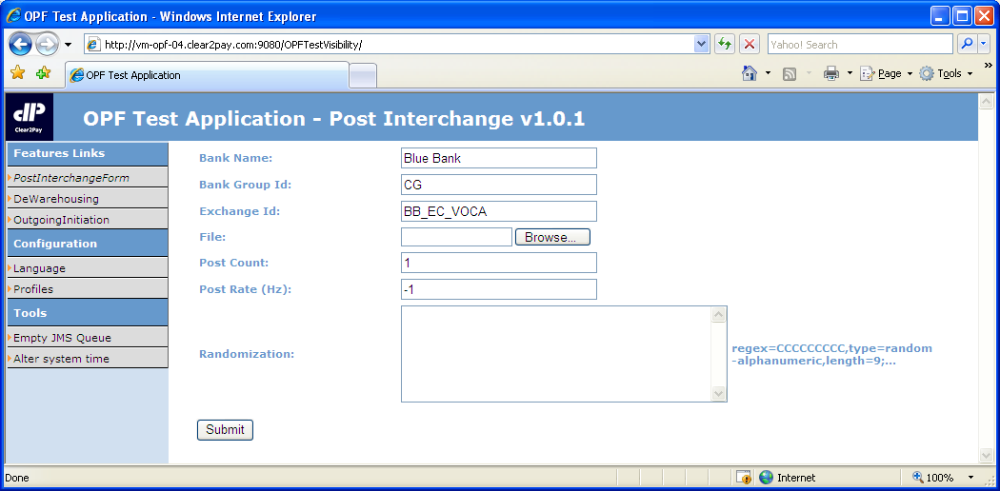
Interchange loader - demo
Interchange Loader – meta data provided
Bank Name
Bank Group Id
Exchange Id
Notes:
Open the Test Visibility Application: http://[server name]:9080/OPFTestVisibility
- Show the PostSwiftInterchangeForm
- Show the Bank’s Bank Name, Exchange Condition’s external id to point out the info the meta data is compared against

Slide 167
Interchange loader
Interchange Loader – meta data derived (i.e. SWIFT messages)
Bank group derived from the Bank, assuming the Bank is uniquely identified within the system
Bank determined by comparing:
Receiving party in block 1 or 2 of the SWIFT message (BIC11 or BIC8)
Bank’s external id

Slide 168
Interchange loader
Exchange Condition of the Bank by comparing:
If present, the Copy Service Code (tag 103) in block 3 of the SWIFT Message (BIC11 or BIC8)
Exchange Condition’s copy service code
Else, Sending party in block 1 or 2 of the SWIFT message
Exchange Condition’s external id
If still not found, Exchange Condition with external id “SWIFTGATEWAY” (e.g. for announcement messages)

Slide 169
OPF Training - Functional Track
OPF Features - Parser and Formatter

Slide 170
Parser/formatter
Parser
Component which reads a message’s raw data, transforms it and retains it in the OPF internal data model
Upon failure of the parser, the complete interchange will be rejected:
Since the interpretation of the message failed, the already read data is not trustworthy.
Makes it difficult to reply in an automated way.
A ‘technical alert/error’ can be logged, which can be captured by alert systems like Tivoli.
Formatter
Component which reads the relevant data from the OPF internal data model, transforms it and creates a message
Part of the submission framework:
The submission service will create an outgoing Instruction (optionally) and Interchange and will enrich these entities
The formatter creates an outgoing message based on the Transaction, outgoing Instruction and outgoing Interchange

Slide 171
OPF Training - Functional Track
OPF Features - Exchange Events – exchange reconciliation

Slide 172
Exchange Events & Exchange Reconciliation
Exchange Events & Exchange Reconciliation
Exchange Events & Exchange Reconciliation, data model recap
Exchange Event information retained:
Direction: indicates whether an Interchange/Instruction/Transaction is received or sent out by the system
Clearing participant: clearing participant related to the event
Settlement day: indicates the settlement day applicable for the exchange event
Transport date: indicates the day and time at which the Interchange for which the exchange event was created has been received or sent
Amount: indicates the amount the exchange event represents
Number of Credit/Debit Transactions: indicates the number of Credit/Debit Transactions related to the event
Sum of amounts of Credit/Debit Transactions: indicates the sum of the amounts of all Credit/Debit Transactions related to the event
Currency of Credit/Debit Transactions: indicates the currency of all Credit/Debit Transactions related to the event
Exchange Event information to be retained can be extended

Slide 173
Exchange Events & Exchange Reconciliation
Exchange Events & Exchange Reconciliation
A summary of the Exchange Events can be consulted from the BVA via the Exchange Reconiliation screen:
All Transactions in the system are taken into account by default
Possible to restrict the exchange recinciliation on:
Bank
Currency
Settlement day (to – from)
Transport date (to –from)
Exchange reconciliation shows:
Per Participant and currency the number of incoming/outgoing debit/credit transactions and total amounts
An aggregated total per currency of the number of incoming/outgoing debit/credit transactions and total amounts

Slide 174
OPF Training - Functional Track
OPF Features - Determine Processing Context

Slide 175
Determine processing context
Recap Services – Products – Agreements
Determination processing context (OPF)
The processing context determination determines the Processing Attributes (e.g. charges configuration, pre-paid charges required,…) that will impact the system’s behavior in processing a payment
The determined set of attributes can be passed on to the respective services that are called throughout the BPEL flow, as a ‘context’ of processing
The processing attribute context could be determined:
At very initial steps of the flow and passed on from one flow to another
Alternatively, at different points in the payment flow, the system may have to re-determine processing attributes, depending on the ‘phase’ the process is in

Slide 176
Determine processing context
Determination processing context (OPF)
The way the processing context is determined:
Can be varied based on the ‘phase’ the payment is in (by providing a context type to the determination of the processing context) E.g. Determine the “settlement processing context” by looking at the settlement Participant’s Agreement etc.
Is ‘implementation’ specific and can vary per Product (SEPA, ICT/DCT,...) and per specific implementation of the Product (project-level)
Will “typically” take the attributes defined on Service, Product or Agreement into account to determine the Processing Attributes

Slide 177


Determine processing context
Determination processing context (xCT) – example charges
Agreement
Agreement
Customer OPF Bank
OPF Bank
USD Correspondent
Instruction
flow
Not on-us
Transaction flow
MT103 (71G:$7)
Instruction flow - detail
Not on-us Transaction flow - detail
Determine processing context
Charges
Routing
Determine processing context
Charges
...
Charge amount = €5
Pre-paid charges = $7
Processing attribute | Value
Charge type config | “OPF Bank Retail standard”
Charge config | “OPF Bank Retail standard”
... | ....
Processing attribute | Value
Charge type config | “OPF Bank Wholesale standard”
Charge config | “USD Correspondent”
Pre-paid | True

Slide 178
Determine processing context
Determination processing context (xCT)
Attributes added as service attributes to determine the processing context:
Processing scheme The ‘scheme’ under which the payment is being processed. E.g. ‘ICT’, ‘SDDCore’, ‘SCT’
Product code A code which indicates the Product which is to be used for a particular payment. The product code is compared against a code provided in the payment.

Slide 179
Determine processing context
Determination processing context (xCT)
Rules to identify the payment’s account to compare the agreement’s processing account against
Instruction classification | Processing Account
FI2FICustomerCreditTransfer / FinancialInstitutionCreditTransfer | Instruction’s settlementAccount
CreditTransferInitiation | Instruction’s originatingPartyAccount
Transaction classification | On-us | Processing Account
CustomerCreditTransfer | True | Transaction’s creditPartyAccount
FinancialInstitutionCreditTransfer | True | Transaction’s creditPartyAccount, if not present use Transaction’s settlementAccount
CustomerCreditTransfer/ FinancialInstitutionCreditTransfer | False | Transaction’s settlementAccount

Slide 180
Determine processing context
Determination processing context (xCT)
Rules to identify processing scheme and product code in the payment
Instruction’s classification | Instruction’s Processing Scheme | Product code from Instruction
FI2FICustomerCreditTransfer / FinancialInstitutionCreditTransfer | Instruction’s processingScheme | Check in both Instruction’s serviceLevelProprietaryCode OR Instruction’s instructionForNextAgent[n]InstructionInformation
CreditTransferInitiation | Instruction’s processingScheme | Instruction’s serviceLevelProprietaryCode
Transaction classification | Scheme
CustomerCreditTransfer/ FinancialInstitutionCreditTransfer | Transaction’s scheme

Slide 181
OPF Training - Functional Track
OPF Features - Validations

Slide 182
Validation framework
Validation framework
Provides a means to validate any entity against flexible validation rules
Validation rules can be grouped, in order to re-use individual validation rules
Common types of validations available:
Mandatory field validation
Date field validation (incl. range validation)
Enumeration validation i.e. whether a field contains a value from a pre-defined set of values
Numeric range validation
Predicate validation i.e. whether an expression validates to true or false
Count validation
Sum validation
...
Notes:
Demo Included – Use file “MT103 Validation Failure”

Slide 183
Validation framework
Validation framework
Can be called from BPEL or the BVA:
Returns an issue to the BPEL if called by BPEL
The error is shown on the BVA if invoked from the BVA

Slide 184
Validation framework
Validations – parser
Some validations are already done in the parser
Validations are done on retained data, therefore the parser already has to detect exceptions to the format.
Examples of such validations:
Amount field:
SWIFT amount format: 125,12
Retained as: 125.12000
Date field:
SWIFT date format: 091108
Retained as: 2009-11-08
Exception handling self done by the validation service
It is possible to integrate customised xsd validations in the parser for SWIFT-MX messages (implementation choice)

Slide 185
Validation framework
Validations – web tier
As for the parser, some validations are done by the web tier instead of the validation service. E.g.:
Some validations of manual entry of payments.E.g. amount
Typically all validations for maintenance via the BVA of static entities.

Slide 186
OPF Training - Functional Track
OPF Features - Possible duplicate check

Slide 187
Possible duplicate check
Possible duplicate check
Validation on certain attributes revealing Instructions that are possibly duplicates of Instructions that are already existing in the system:
Having the same incoming Clearing Condition
Within a configurable time range
The attributes are configurable
An issue is raised upon detection of a possible duplicate Instruction
Outcome can be Instruction approval, other outcomes are possible too (e.g. Reject)

Slide 188
Possible duplicate check

Slide 189
OPF Training - Functional Track
OPF Features - Disposition check

Slide 190
Disposition check
Disposition check
The Disposition Check Service centralizes the validations that can be performed on accounts (debit and/or credit):
Account existence
Checks whether the account exists or not
An Issue is raised if the account does not exist
Outcome of the Reference Implementation can be to send the Payment to manual repair
Account status
Checks the status of the account (open, closed, blocked)
An Issue is raised if the account does not exist
Outcome of the Reference Implementation can be to:
Reject the Payment if the account is closed
Send the Payment to approval if the account is blocked The payment can next be sent to manual repair by the user
A substitute account can be returned. The original account is next replaced with the substitute account
Notes:
Demo Included – Use file “MT101_Disposition Check” – this will check for account existence

Slide 191
Disposition check
Disposition check
Account currency
If the account’s currency is present in the payment (Instruction/Transaction), checks whether an account exists with this currency
An Issue is raised if the account’s currency does not exist
Outcome of the Reference Implementation can be to send the payment to approval The payment can next be sent to manual repair by the user
If the account’s currency is not present in the payment (Instruction/transaction), retrieves the account’s currency and enriches the payment with the account’s currency

Slide 192
Disposition check
Disposition check
Sufficient funds
Checks whether sufficient funds is available on the account
An Issue is raised if insufficient funds available
Outcome of the Reference Implementation can be to send the payment to approval The payment can next be sent to manual repair by the user
A reservation Id can be returned and is retained, so it can be provided whenever required (e.g. Accounting)
Release reserved funds This feature can be called by any service to release reserved funds

Slide 193
Disposition check
There are several possible ways for the Disposition Check to get the information from the Accounting Management System:
Via an OPF AMS Account table (sufficient funds check is not supported in this solution)
Via an external AMS: request – reply

Slide 194
Disposition check
Disposition check invoked from the flow:
Account existence and status check
Account currency check
Account Existence, Status and fund availability check
First step of each check is determining which account to check. The account is selected based on:
The payment entity the disposition check is done for (e.g. Payment Instruction)
The disposition check type, which is an input parameter of the service (e.g. Payment or Charges)
The payment’s classification (e.g. FI2FICustomerCreditTransfer)
Payment being On-us or not on-us

Slide 195

Disposition check - demo
Disposition check – account existence
A payment received from a customer has a non-existing account
Manual repair is invoked to correct the account. Existing debit party account is:
Account: BE61310126985517
Account Id Type: IBAN
Account Currency: EUR
4-eye verification is required next before the payment can be processed further
Account
does not
exist
Big Company,
Belgium
XCT BANK-1
(XCTABEBB)
Notes:
Stop Point: Include Demo

Slide 196
OPF Training - Functional Track
OPF Features - Approval

Slide 197
Approval
Approval
Refers to the functionality which is offered to a user to approve a payment prior to processing it further
Approval can be invoked from the Interchange/Instruction/Transaction flow:
The Issue Processor can be configured to trigger approval, after which the approval type for the issue at hand is invoked
Underlying entities are not processed further until the upper entity has been approved

Slide 198
Approval
Approval – invoked from an Interchange, Instruction or Transaction flow
An issue is raised by a certain service (e.g. Disposition check on account status failed – account blocked)
The Issue Processor determines the outcome as approval
The approval service is invoked with a certain approval type, related to the issue which occurred
A history record and Work List Item (optionally) is created, and the Payment waits until it is approved
Actions a user can take from the BVA for a certain approval type:
Approve and retry the service that caused the issue
Approve and Continue processing the Interchange/Instruction/Transaction
Decline the payment, after which the payment is rejected
Send the payment to repair

Slide 199
Approval
Approval – invoked from an Instruction or Transaction flow
Before continuing processing or retry executing the previous service, the payment might require 4-eye verificiation
The payment continues processing after the payment has been 4-eye verified
The Work List Item is completed

Slide 200
Approval
Issue | Possible user actions
Transaction routing failure | Retry routing: the user updates the routing rules and retries Send the Transaction to manual repair Reject Transaction
PDE/PDM Duplicate check failure | Continue processing: the user determines the Interchange is not a duplicate and decides to continue processing Reject Interchange
Disposition Check Failure | Retry disposition check: the problem is resolved and the user retries disposition check Send the Instruction/Transaction to manual repair Reject Instruction/Transaction
Possible duplicate Instruction | Continue processing: the user determines the Instruction is not a duplicate and decides to continue processing Reject Instruction
Code word detected | Continue processing: the user does the action required by the code word (e.g. Phone beneficiary) and decides to continue processing the Instruction/Transaction Reject Instruction/Transaction
Risk filter check | Continue processing: the user identified the risk filter hit as a false positive and decides to continue processing the payment Reject Instruction/Transaction: the user identified the payment cannot be executed due to the risk imposed with settling the payment and rejects the payment.
No charge configuration found | Retry: the user adds the required charge configuration to determine charges for the payment at hand and decides to retry charge calculation Reject Instruction/Transaction
No rate type found | Retry: a system admin adds the required rate type configuration to determine the forex rate type to use for the payment at hand. A user decides to retry currency conversion. Reject Instruction/Transaction
No/multiple Agreements found | Retry: the user adds the Agreement and decides to continue processing Reject Instruction/Transaction
Missing Business Calendar | Retry: a system adds the required business calendar. A user retries processing the payment Reject Instruction/Transaction

